Slide 1



VIVEKANAND EDUCATION SOCIETY’S INSTITUTE OF TECHNOLOGY
Department Of Information Technology
DSA MINI PROJECT
MEDIDIAGNOSE
A.Y.2024-25
Under the guidance of Professor Kajal Jewani

Slide 2

OUR TEAM
26
27
28
Afnan Kazi
Chaitanya Kelkar
Jay Kerkar

Slide 3
CONTENT
01
INTRODUCTION TO THE PROJECT
10
ALGORITHM EXPLANATION
02
PROBLEM STATEMENT
11
TIME AND SPACE COMPLEXITY
03
12
FRONT END
OBJECTIVES OF THE PROJECT
13
CODE
04
SCOPE OF THE PROJECT
14
CHALLENGES AND SOLUTIONS
05
REQUIREMENTS OF THE SYSTEM (HARDWARE, SOFTWARE)
15
FUTURE SCOPE
06
RELATIONAL SCHEMA
16
OUTPUT SCREENSHOTS
07
UML DIAGRAM
17
CONCLUSION
08
GANTT CHART
18
REFERENCES (IN IEEE FORMAT)
09
DATA STRUCTURE & CONCEPTS USED

Slide 4



INTRODUCTION TO PROJECT
MediDiagnose is an innovative medical application designed to streamline the patient diagnosis process. The platform allows healthcare providers to efficiently manage patient interactions, from registration and login to diagnosing symptoms and generating medical reports.
Key Features
User Registration and Login: Secure account creation and login for patients.
Symptom Tracking: Healthcare professionals can record and view patient symptoms for accurate diagnosis.
Report Generation: Automatic generation of detailed medical reports based on symptoms and diagnosis.
Email Integration: Reports are sent to the patient's email for convenient documentation delivery.

Slide 5
PROBLEM STATEMENT
Healthcare providers struggle with managing patient data, tracking symptoms, and generating reports efficiently. Manual documentation leads to errors and delays in communication. There is a lack of streamlined systems for accurate report generation and delivery. An automated, secure platform is needed to enhance diagnosis and ensure seamless report sharing.

Slide 6





OBJECTIVES OF THE PROJECT
Objective 1
Objective 2
Objective 3
To develop a secure system for patients to register, log in, and manage their accounts.
To streamline the process of recording patient symptoms and generating accurate medical reports.
To automate the delivery of medical reports via email, ensuring timely and efficient communication between healthcare providers and patients.

Slide 7
SCOPE OF THE PROJECT
User Registration and Authentication: Implement a secure system for users (patients) to register, log in, and manage their accounts.
Symptom Tracking: Create a comprehensive interface for doctors to input and monitor patient symptoms, allowing for accurate diagnosis.
Medical Report Generation: Develop a feature to automatically generate medical reports based on the recorded symptoms and diagnosis.
Email Integration: Ensure that the platform sends generated reports to the patient’s registered email address in a secure and timely manner.
Future Expansion: The project can be scaled to include additional features such as appointment scheduling, telemedicine integration, and a more advanced diagnostic AI system to assist in complex cases.

Slide 8



REQUIREMENTS
Software:
OS: Linux, Windows
Compiler: GCC (or MinGW for Windows)
Libraries: cJSON, libcurl
Hardware:
Processor: Any single-core processor
RAM: 2GB minimum
Storage: Less than 100 MB

Slide 9
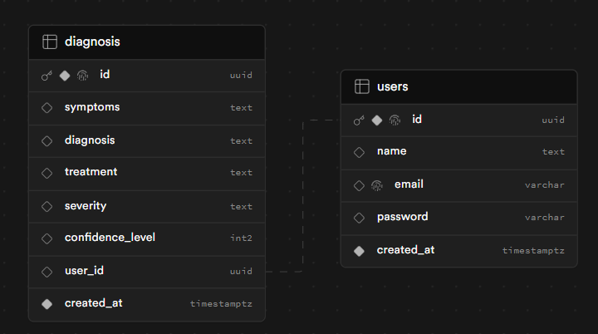
RELATIONAL SCHEMA

Slide 10
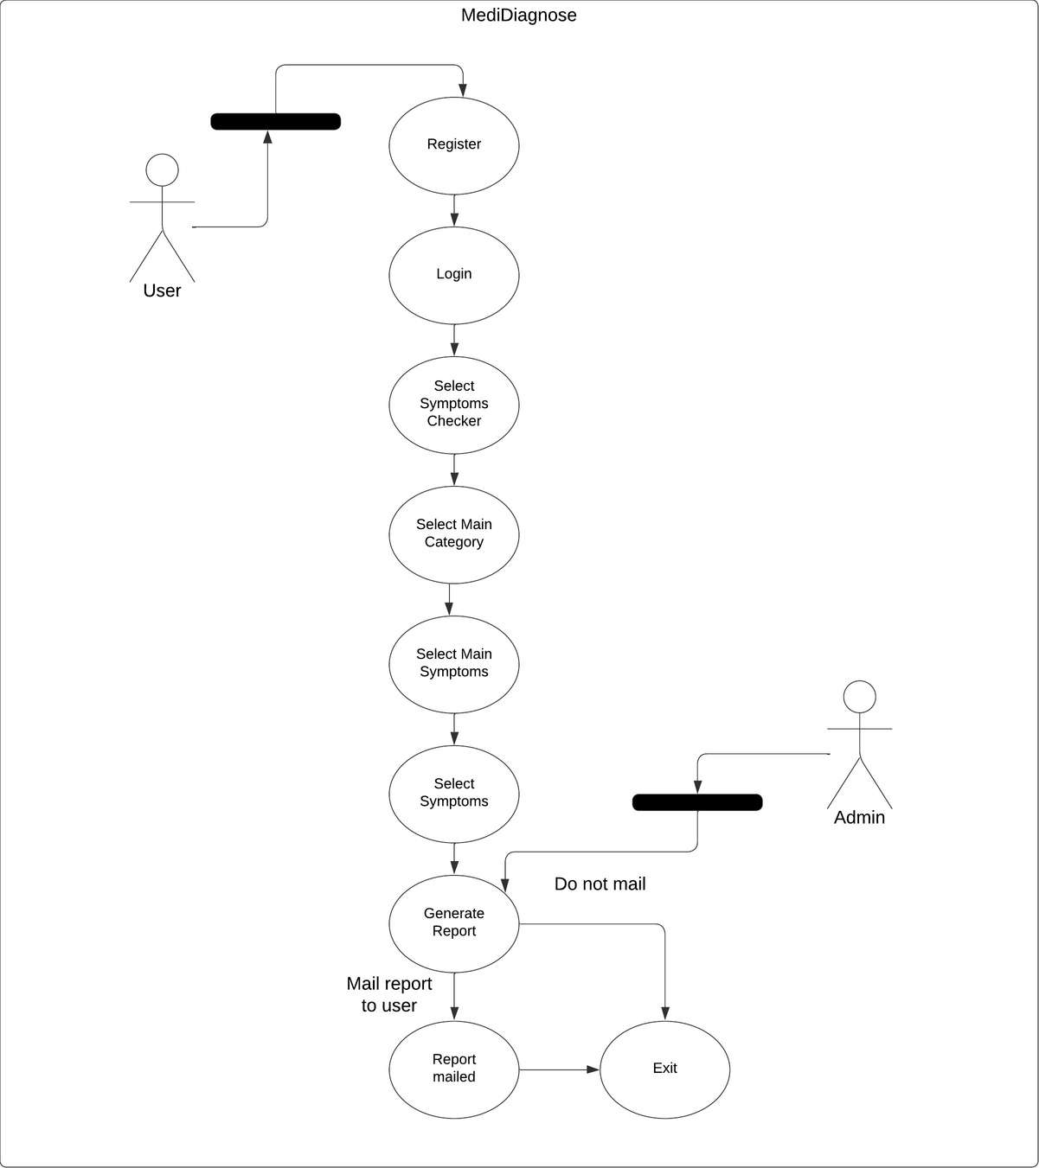
UML DIAGRAM

Slide 11
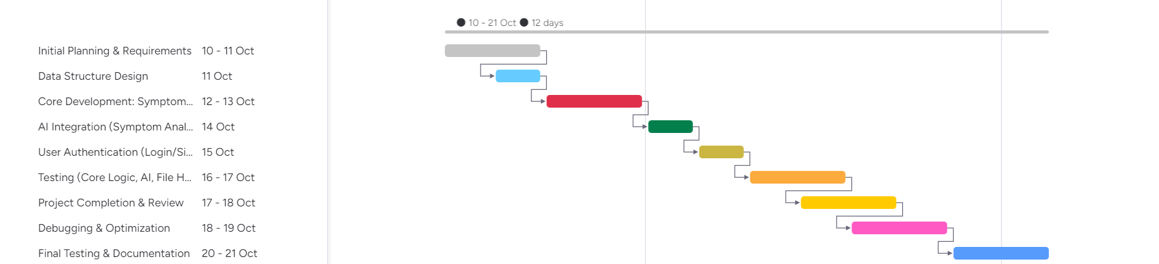
GANTT CHART

Slide 12
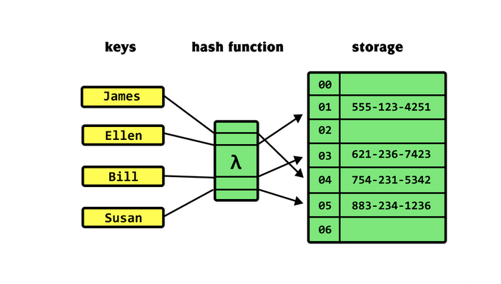
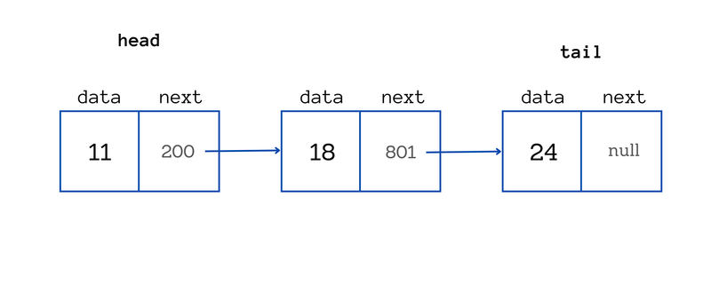
DATA STRUCTURES
Hash Table
Stores key-value pairs for fast data retrieval.
Average-case 𝑂(1)
O(1) time complexity for inserts/looks.
Collision resolution via linked lists.
Linked List
Linear data structure with nodes containing data and references.
Used to manage symptoms dynamically.
Efficient insertions and deletions.

Slide 13
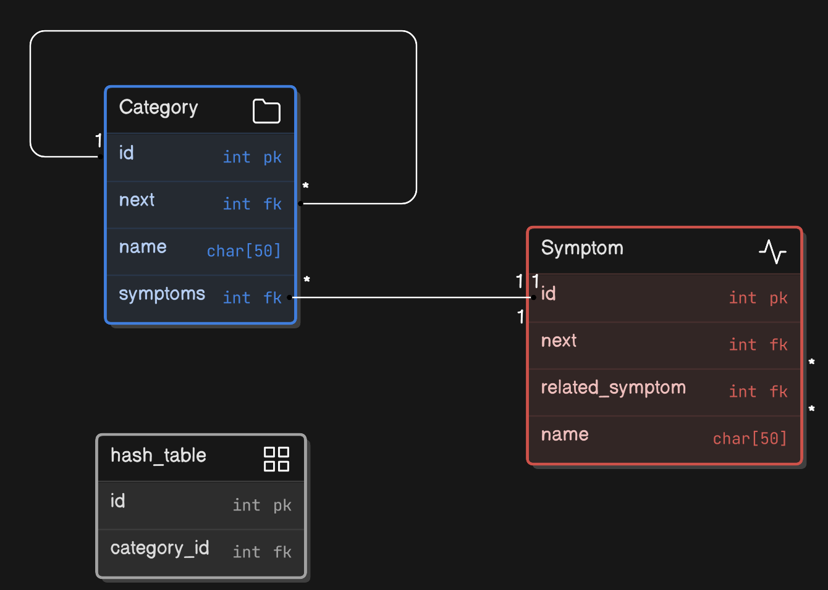

Slide 14
ALGORITHM EXPLANATION
Hash Function:
Computes index for storing categories.
Ensures efficient access to data.
Category and Symptom Management:
Functions for creating, inserting, and finding categories and symptoms.
Ensures data integrity and retrieval efficiency.
Symptom Calculation:
Functions to count symptoms in categories and related symptoms.
Utilizes linked lists for dynamic data handling.
JSON Parsing:
Parses input data to populate categories and symptoms.
Handles related symptoms efficiently.

Slide 15
PROGRAM COMPLEXITY
Time Complexity: O(n * m) for n items in the JSON and m related symptoms.
Space Complexity: O(c + s + n), accounting for categories, symptoms, and the JSON string.

Slide 16
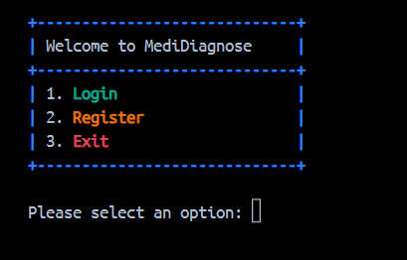
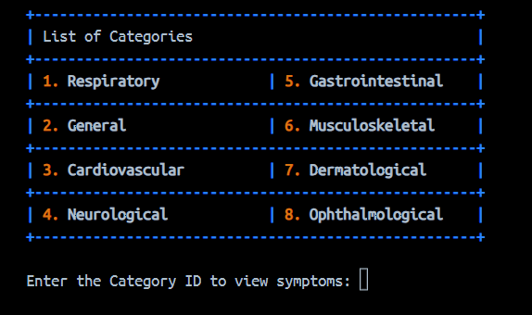
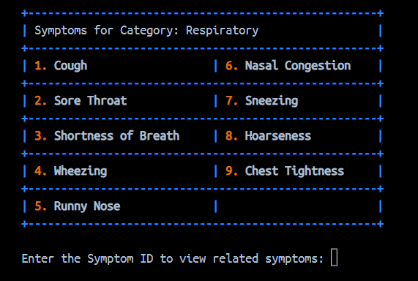
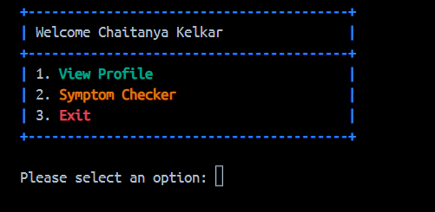
FRONTEND
1.
3.
2.
4.

Slide 17

CODE
MediDiagnose- AI Enhanced medical diagnosis assistant

Slide 18
CHALLENGES AND
SOLUTIONS
Data Privacy and Security
Challenge: Managing sensitive patient information raises concerns about data breaches and privacy violations.
Solution: Implement robust encryption, access controls, and compliance with regulations like HIPAA. Conduct regular security audits and provide training on data protection to mitigate risks.
2.Accuracy of AI Diagnoses
Challenge: We faced a challenge in generating the report from the AI model, as it doesn't consistently produce positive outputs.
Solution: we need to test various token limits to better understand the model's behavior
3. User Adoption and Engagement
Challenge: Patients and healthcare providers may resist using new technology due to a lack of familiarity or trust.
Solution: Create user-friendly interfaces and offer comprehensive training and support. Building trust through transparent AI processes and showcasing successful case studies can encourage adoption.

Slide 19
FUTURE SCOPE
AI-Powered Diagnosis Improvement: Enhance AI to analyze patient data for more accurate and tailored diagnoses.
Integration with Wearable Devices: Connect with wearables for real-time health monitoring and proactive care.
Telemedicine Integration: Add video consultations for remote diagnosis and follow-ups, improving access to healthcare.
Predictive Analytics and Alerts: Use predictive analytics to notify patients of potential health risks, promoting preventive care.

Slide 20
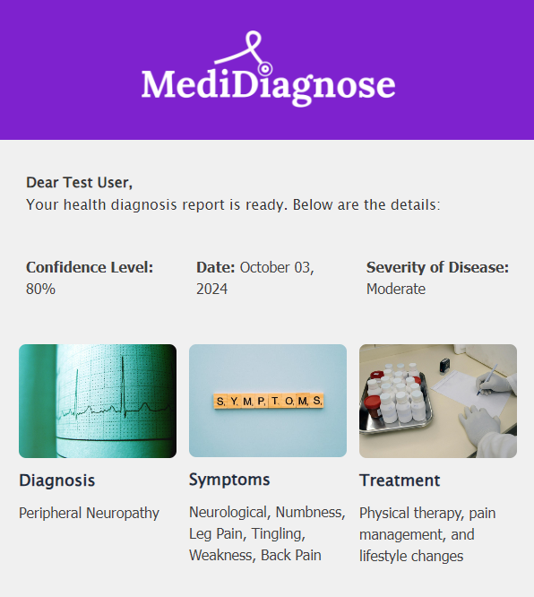
OUTPUT SCREENSHOT

Slide 21
CONCLUSION
MediDiagnose holds significant promise for transforming healthcare through its innovative use of AI and technology. By addressing challenges such as data privacy, diagnostic accuracy, user adoption, and system integration, and implementing robust solutions, MediDiagnose can enhance patient care, streamline processes, and improve health outcomes. With ongoing development and commitment to innovation, MediDiagnose has the potential to become a vital tool in the healthcare landscape, fostering proactive and personalized medical solutions for patients and healthcare providers alike.

Slide 22
REFERENCES
Llama 3: Herd of Language Models
Meta Technical Paper
Next-Generation Healthcare
Diagnostics Journal, MDPI
The FNV-1A Hash Algorithm
Internet Engineering Task Force (IETF) Draft

Slide 23

THANK YOU

